Slide 1
RICH AND POOR
PRESENTED BY
SUSHIL VARMA

Slide 2
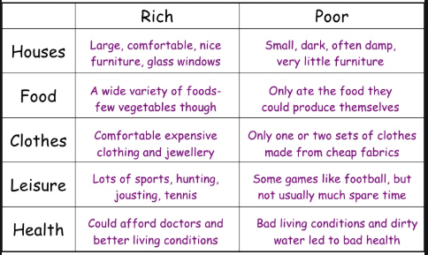

Slide 3
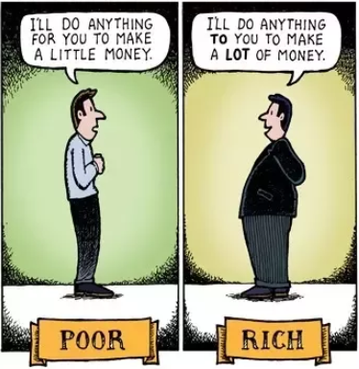

Slide 4
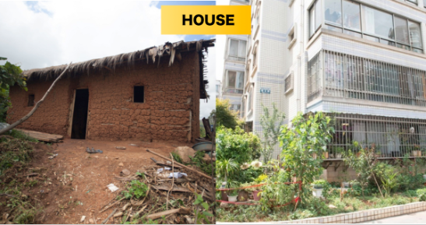

Slide 5
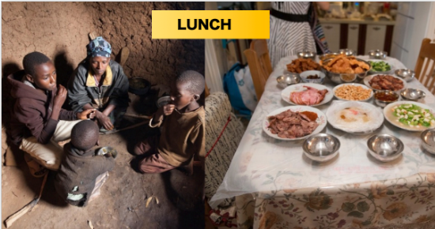

Slide 6
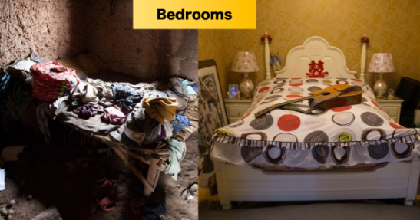

Slide 7
THANK YOU

